Slide 1

Lecture 3: Strings, Pointers, Memory Allocations, Structures
Dr. Amir Yavariabdi
amir.yavariabdi@bth.se
1

Slide 2
Outline:
Strings and Multidimensional Strings
Pointers and their role in C programming
Dynamic Memory Allocation.
Introduction to Structures in C.

Slide 3
String
A string is a specific type of array:
it is an array of char, containing a sequence of values where a value of ’\0’ signifies the end of the string.
Although the array could be of any size, it is assumed that the valid data in the array
starts at the first cell, and
ends with the first cell having a value of ’\0’.
For example:
char d[8];
d[0]=’H’; d[1]=’e’; d[2]=’l’; d[3]=’l’; d[4]=’o’;
d[5]=’\0’; /* ’\0’ indicates the end of string */
Although the array has eight cells, only the first six are used.
The cell containing the ’\0’ character is not seen during either printing or the scanning of input.
The slash-symbol pair within the single quotes is called an escape sequence and is used to represent the nonprintable character.

Slide 4
String: printf and scanf
The basic functions for reading string input from the keyboard and for writing string output to the screen are scanf() and printf(), respectively.
Just as each basic data type has its own % identifier (char uses %c, int uses %i or %d, float uses %f, double uses %lf), a string uses %s.
printf("%s\n",d);
When reading input using the scanf() function, the & symbol is required in front of the variable name for the basic data types (char, int, float, and double). However, it is not required for a string.
int x;
float f;
char s[6];
scanf("%d",&x);
scanf("%f",&f);
scanf("%s",s);

Slide 5
Example 1: String
Write code to split an input string (variable “name”) into two output strings (variables “first” and “last”).
Assume that the user provides input containing only the characters a through z and A through Z. Assume there are exactly two capital letters in the input, one at the beginning of the first name, and one at the beginning of the last name.
For example, given the input “JoeSmith”, your code should split it into “Joe” and “Smith”. Your code should use the following lines:
char name[50],first[25],last[25];
printf("What is your name? ");
scanf("%s",name);

Slide 6
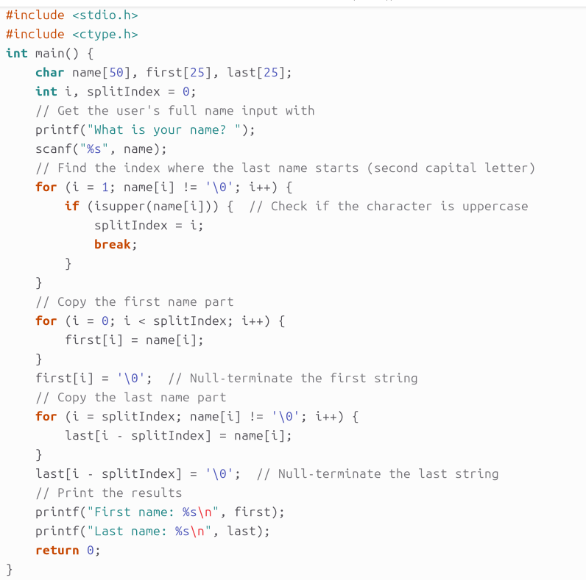
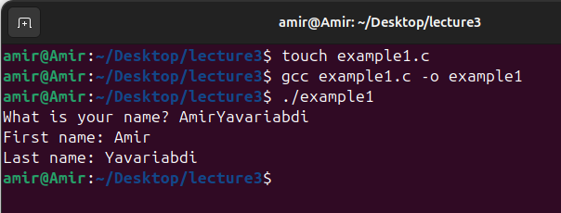
Example 1: String

Slide 7
Example 1: Explanation
#include <stdio.h>: This includes the standard input/output library, which allows us to use functions like printf and scanf.
#include <ctype.h>: This includes the character type library, giving us access to functions like isupper, which checks if a character is uppercase.
Variables:
name[50]: An array to store the full name entered by the user (e.g., "AmirYavariabdi").
first[25]: An array to store the first name after splitting.
last[25]: An array to store the last name after splitting.
splitIndex: An integer to store the index where the last name starts.

Slide 8
Example 1: Explanation
Copying the First Name:
A loop runs from the start of the name string up to splitIndex.
from "AmirYavariabdi“, we copied "Amir" to the first array
first[i] = '\0'; adds a null terminator to mark the end of the first name string.
Copying the Last Name:
Another loop runs from splitIndex (index 4) to the end of the name string.
Characters from "Yavariabdi" are copied to the last array.
last[i - splitIndex] = '\0'; adds a null terminator to mark the end of the last name string.
Output:
The program prints the first and last names.

Slide 9
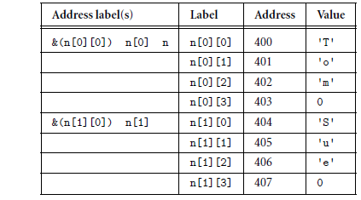
Multidimensional String
One of the common uses for multidimensional arrays is to store a list of strings.
Since each string is a one-dimensional array, a list of strings requires a two dimensional array.
For example:
char n[2][4];
n[0][0]=’T’; n[0][1]=’o’; n[0][2]=’m’; n[0][3]=0;
n[1][0]=’S’; n[1][1]=’u’; n[1][2]=’e’; n[1][3]=0;
Each string in the two-dimensional array can be referenced using the address label for the one-dimensional array that stores it.
For example, the following code prints out the two strings:
printf("%s %s\n",n[0],n[1]);
Both n[0] and n[1] identify addresses (400 and 404, respectively).

Slide 10
Example 2: Multidimensional String
Write a C program that initializes and manipulates a multidimensional array of strings.
Task:
Define a 2D array of strings to store 3 names, each up to 20 characters long.
Initialize the array with the names of three people.
Print each name along with its length.
Modify the second name in the array.
Print the updated list of names with their new lengths.

Slide 11
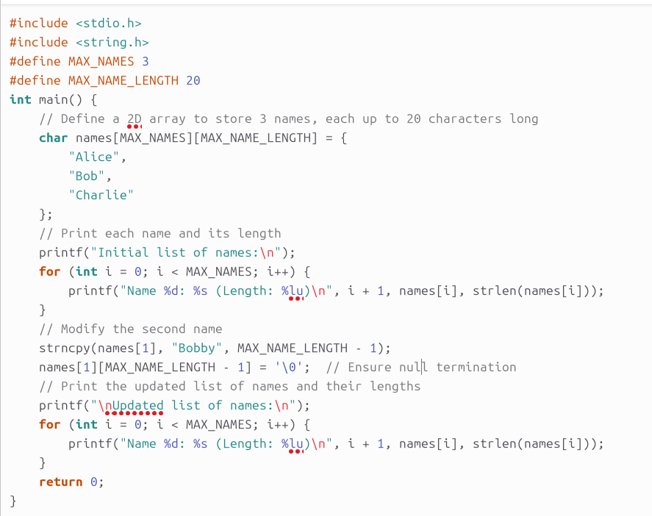
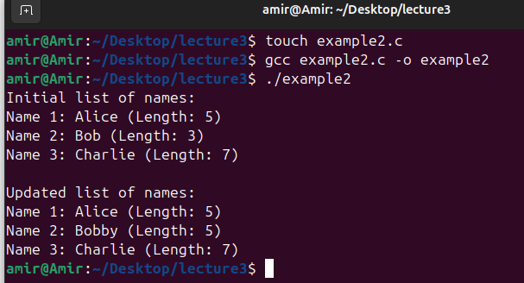
Example 2: Multidimensional String

Slide 12
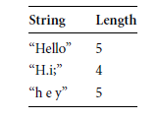
Example 2: Explanation
Array Definition:
char names[MAX_NAMES][MAX_NAME_LENGTH] creates a 2D array where MAX_NAMES is the number of names (3 in this case) and MAX_NAME_LENGTH is the maximum length of each name (20 characters).
Initialization:
The array names is initialized with three names: "Alice", "Bob", and "Charlie".
Printing Names and Lengths:
A for loop is used to iterate through the names array. For each name, the printf function displays the name and its length using strlen(names[i]).

Slide 13
Example 2: Explanation
Modifying a Name:
The strncpy function is used to copy "Bobby" into the second position of the array (names[1]). The MAX_NAME_LENGTH - 1 ensures that we do not exceed the array bounds. The last character is set to '\0' to ensure null termination.
Printing Updated Names:
Another for loop is used to print the updated names and their lengths.

Slide 14
Pointers
A pointer is a construct used to store an address of a variable.
We declare a variable to be a pointer-type variable by preceding its name with the asterisk symbol (*).
For example:
char c,*cp;
int i,*ip;
float f,*fp;
double d,*dp;
The variables c, i, f, and d are normal variables, each holding a different type of value.
The variables cp, ip, fp, and dp are all pointers, each holding an address.

Slide 15
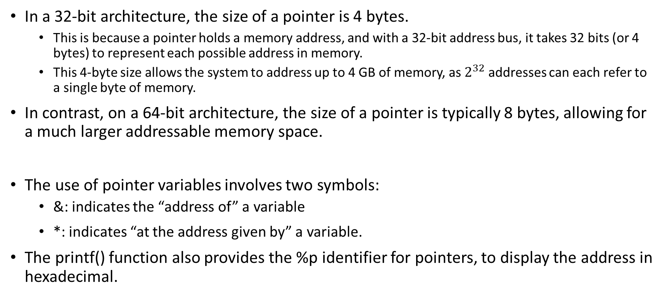
Pointers
In a 32-bit architecture, the size of a pointer is 4 bytes.
This is because a pointer holds a memory address, and with a 32-bit address bus, it takes 32 bits (or 4 bytes) to represent each possible address in memory.
This 4-byte size allows the system to address up to 4 GB of memory, as $2^{32}$ addresses can each refer to a single byte of memory.
In contrast, on a 64-bit architecture, the size of a pointer is typically 8 bytes, allowing for a much larger addressable memory space.
The use of pointer variables involves two symbols:
&: indicates the “address of” a variable
*: indicates “at the address given by” a variable.
The printf() function also provides the %p identifier for pointers, to display the address in hexadecimal.

Slide 16
Example 3: Pointer
Write a C program to demonstrate the use of pointer symbols * (dereferencing) and & (address-of).
Task:
Define an integer variable and a pointer to an integer.
Assign the address of the integer variable to the pointer.
Use the pointer to modify the value of the integer variable.
Print both the address and value of the integer variable using both the pointer and the address-of operator.
Show how to use the dereferencing operator to access and modify the integer variable’s value.

Slide 17
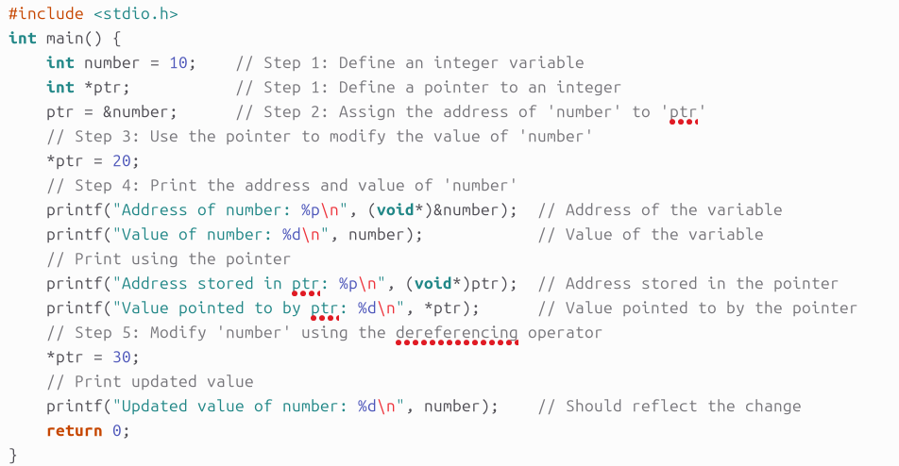
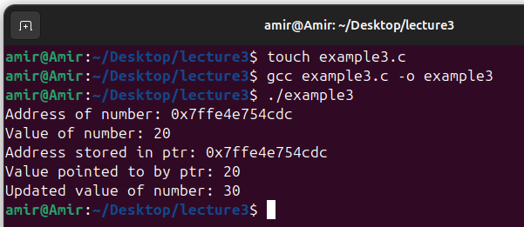
Example 3: Pointer

Slide 18
Example 3: Explanation
Variable and Pointer Definition:
int number = 10; creates an integer variable number and initializes it to 10.
int *ptr; declares a pointer ptr to an integer.
ptr = &number; assigns the address of number to the pointer ptr using & operator.
*ptr = 20; uses the dereferencing operator * to change the value at the address stored in ptr.
Printing Values and Addresses:
printf("Address of number: %p\n", (void*)&number); prints the address of number using the & operator.
The C standard specifies that %p should be used with void*. Using (void*) ensures that the code is standard-compliant and portable across different platforms and compilers.
Even though &number is technically a pointer, to match the type that %p expects, it is good practice to use it with void*. This ensures that there are no warnings or issues, particularly in more strictly typed environments or with certain compilers.

Slide 19
Example 3: Explanation
Printing Values and Addresses:
printf("Address of number: %p\n", (void*)&number); prints the address of number using the & operator.
The C standard specifies that %p should be used with void*. Using (void*) ensures that the code is standard-compliant and portable across different platforms and compilers.
Even though &number is technically a pointer, to match the type that %p expects, it is good practice to use it with void*. This ensures that there are no warnings or issues, particularly in more strictly typed environments or with certain compilers.
printf("Address stored in ptr: %p\n", (void*)ptr); prints the address stored in ptr.
printf("Value pointed to by ptr: %d\n", *ptr); prints the value at the address stored in ptr.
Modifying Again:
*ptr = 30; modifies number again using the pointer.

Slide 20
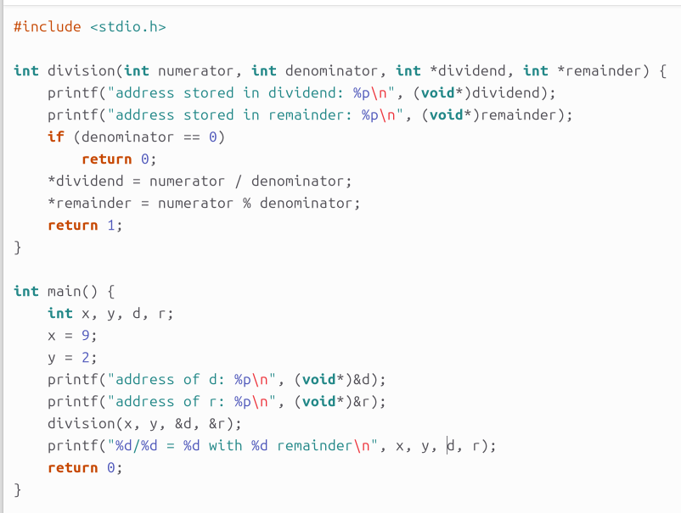
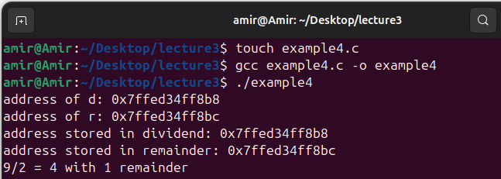
Using Pointers: Passing Values Back from a Function
The most common reason for using pointers is to pass values back from a function.
Consider the following example (example 4):

Slide 21
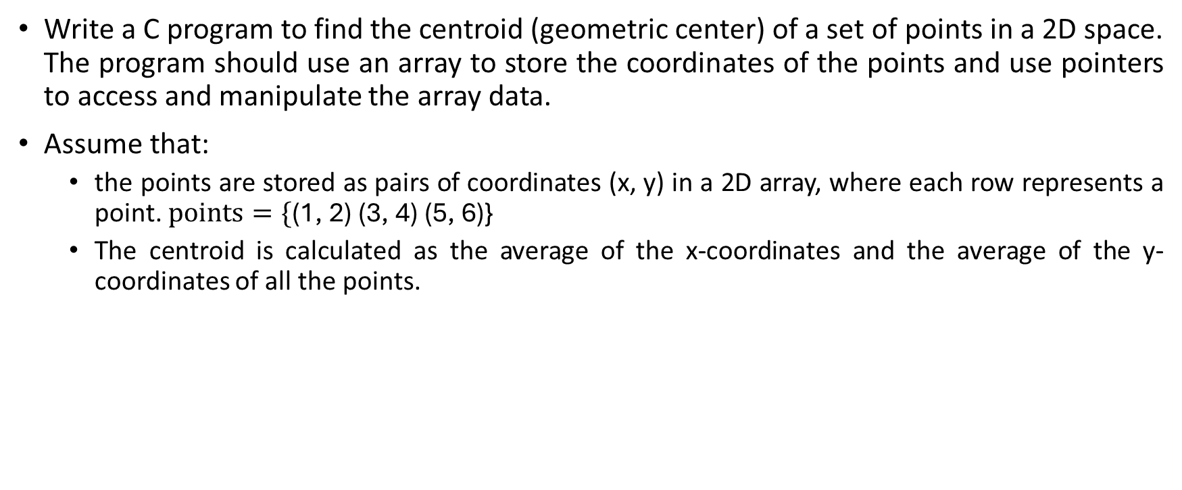
Example 5: Passing Values Back from a Function
Write a C program to find the centroid (geometric center) of a set of points in a 2D space. The program should use an array to store the coordinates of the points and use pointers to access and manipulate the array data.
Assume that:
the points are stored as pairs of coordinates (x, y) in a 2D array, where each row represents a point. $points=\text{\{}\text{(1, 2) (3, 4) (5, 6)}\text{\}}$
The centroid is calculated as the average of the x-coordinates and the average of the y-coordinates of all the points.

Slide 22
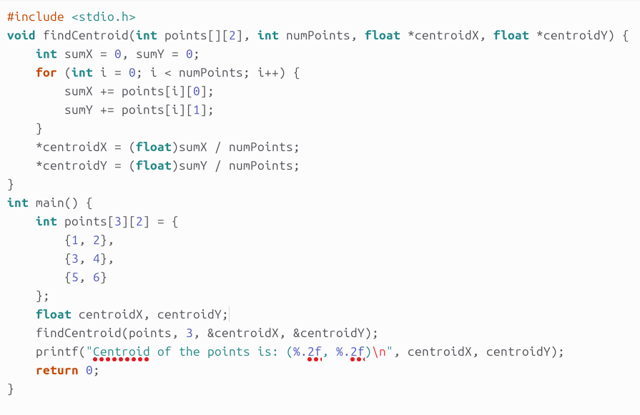
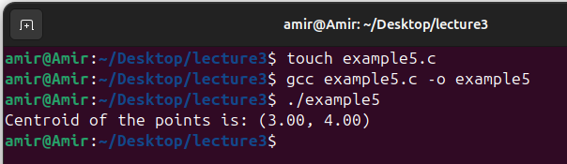
Example 5: Passing Values Back from a Function

Slide 23
Using Pointers: Pointers and Arrays
The second most common use of a pointer is when an array is used.
Pointer: A variable that stores the memory address of another variable.
Array: A collection of elements stored in contiguous memory locations.
Pointer and Array Relationship:
The name of an array acts as a pointer to the first element.
You can use pointers to traverse and manipulate array elements.
Array Access: array[i] is equivalent to *(array + i).
Pointer Arithmetic: *(ptr + i) accesses the element at index i.

Slide 24
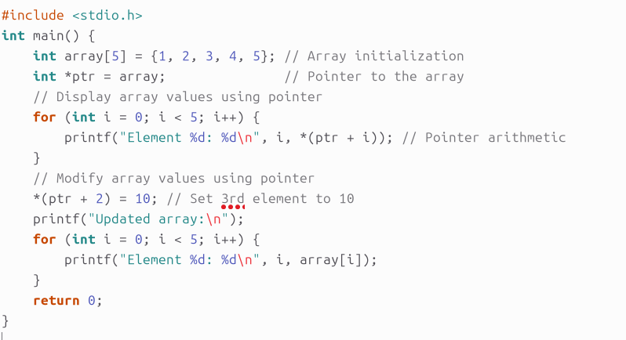
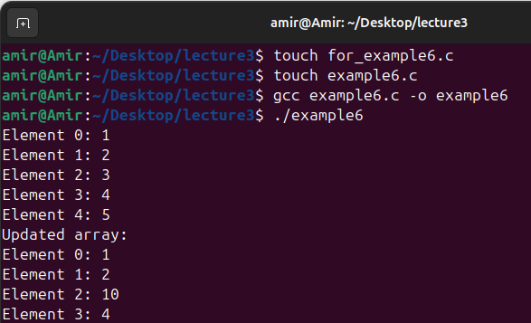
Example 6: Pointers and Arrays
Write a C program that demonstrates how to use pointers to access and modify elements in an array.
Task:
The program should initialize an array of 5 integers,
display its elements using pointer arithmetic,
modify one of the elements through the pointer, and
then display the updated array.
ptr is a pointer to the first element of the array.
ptr points to the first element, so *(ptr + i) accesses elements like array[i]

Slide 25
Dynamic Memory Allocation
Static Memory Allocation:
Space for variables is allocated at compile time.
This means that the size (in bytes) of each of the variables is known before the program runs.
Upon starting execution of the program, the operating system (O/S) finds a place in memory for all the global variables in the program.
The entire time that the program is running, the size of a variable does not change.
Static memory allocation is efficient but inflexible for variable-sized data.

Slide 26
Dynamic Memory Allocation
Sometimes a program does not know how much memory it needs prior to execution.
For example, in reading a line of text from a file, the program might not know how big a string is needed to store all the words before the file has been selected and read.
In this case, a programmer might decide to declare a string of sufficient size to store any possible line of text.
This is wasteful and perhaps, in some cases, impossible.
The maximum size of something to be read might not be known beforehand.
The alternative is to use dynamic memory allocation.

Slide 27
Dynamic Memory Allocation
Key Functions:
malloc(size_t size)
Allocates size bytes of memory.
Syntax: void *ptr = malloc(size);
Returns: Pointer to allocated memory or NULL if allocation fails.
calloc(size_t num, size_t size)
Allocates memory for an array of num elements, each of size size. Initializes all bytes to zero.
Syntax: void *ptr = calloc(num, size);
Returns: Pointer to allocated memory or NULL if allocation fails.

Slide 28
Dynamic Memory Allocation
Key Functions:
realloc(void *ptr, size_t new_size)
Resizes an existing memory block.
Syntax: void *new_ptr = realloc(ptr, new_size);
Returns: Pointer to reallocated memory or NULL if reallocation fails.
free(void *ptr)
Deallocates previously allocated memory.
Syntax: free(ptr);
Usage: Releases memory back to the system.

Slide 29
Example 7: Dynamic Memory Allocation
Write a C program that demonstrates the use of malloc, calloc, realloc, and free for managing dynamic memory. The program should:
Allocate memory for an array of integers using malloc and initialize the array with values.
Use calloc to allocate memory for a new array and initialize it with zeroes.
Resize the array using realloc to accommodate more elements.
Free the allocated memory at appropriate places to avoid memory leaks.
Print the contents of each array before and after resizing.
Requirements:
Initial array of 5 integers and initialize them with consecutive values starting from 1.
Allocate a second array of 10 integers using calloc, all initialized to 0.
Resize the first array to hold 10 integers and set new values in the resized portion.
Print the contents of both arrays before and after resizing.
Free all allocated memory before the program exits.

Slide 30
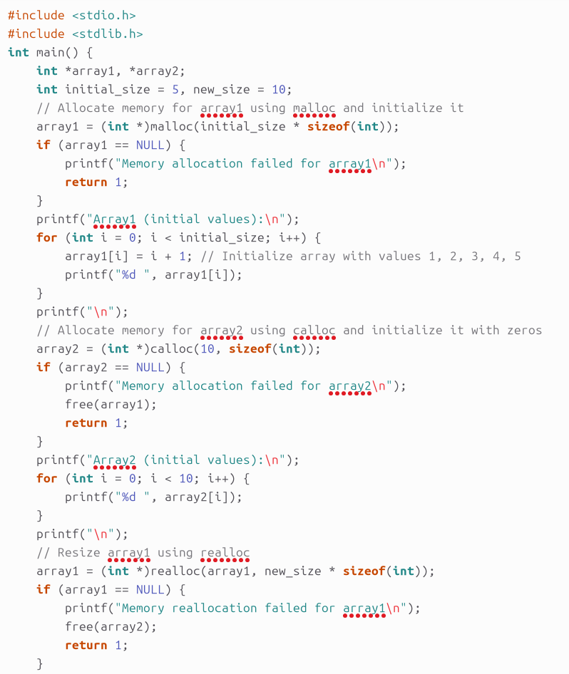
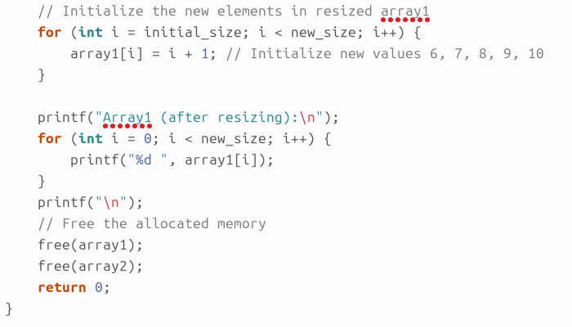
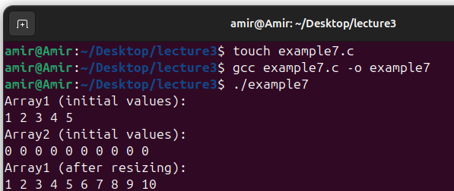
Example 7: Dynamic Memory Allocation

Slide 31
Example 7: Explanation
In C programming, the stdlib.h header file is crucial for several reasons related to dynamic memory management, process control, and utility functions such as malloc, calloc, realloc, and free.
malloc Usage:
Allocates memory for array1 to hold 5 integers.
Initializes array1 with values 1 through 5.
calloc Usage:
Allocates memory for array2 to hold 10 integers, all initialized to 0.
realloc Usage:
Resizes array1 to hold 10 integers.
Initializes the newly allocated space with values 6 through 10.
free Usage:
Frees the memory allocated for both array1 and array2 to prevent memory leaks.

Slide 32
Memory Leak Problem
In C, when you allocate memory dynamically using malloc(), the allocated memory remains reserved for your use until you explicitly release it using free().
However, if you overwrite the pointer to this allocated memory without freeing it, you lose access to that memory block.
double *a;
a = (double *)malloc(70); // Allocates 70 bytes of memory
a = (double *)malloc(300); // Allocates 300 bytes of memory, overwriting the previous address stored in 'a'

Slide 33
Memory Leak Problem
double *a;
a = (double *)malloc(70); // Allocates 70 bytes of memory
a = (double *)malloc(300); // Allocates 300 bytes of memory, overwriting the previous address stored in 'a’
The address of the 70-byte memory block is lost, and we no longer have a way to access or free that memory.
The 70 bytes of memory are still reserved by the operating system, but since your program has lost the pointer to that memory, it becomes a memory leak.
Memory leaks lead to wasted memory and can eventually cause the program to run out of memory if they accumulate over time.
To avoid memory leaks, always ensure that you free() any previously allocated memory before overwriting the pointer.

Slide 34
Double Pointers
Double Pointers Overview:
Definition: A pointer to a pointer, used to handle arrays of pointers.
Syntax: type **ptr;
Benefits of Using Double Pointers:
Flexibility in creating and managing multidimensional arrays dynamically.
Useful for functions that need to modify array dimensions.

Slide 35
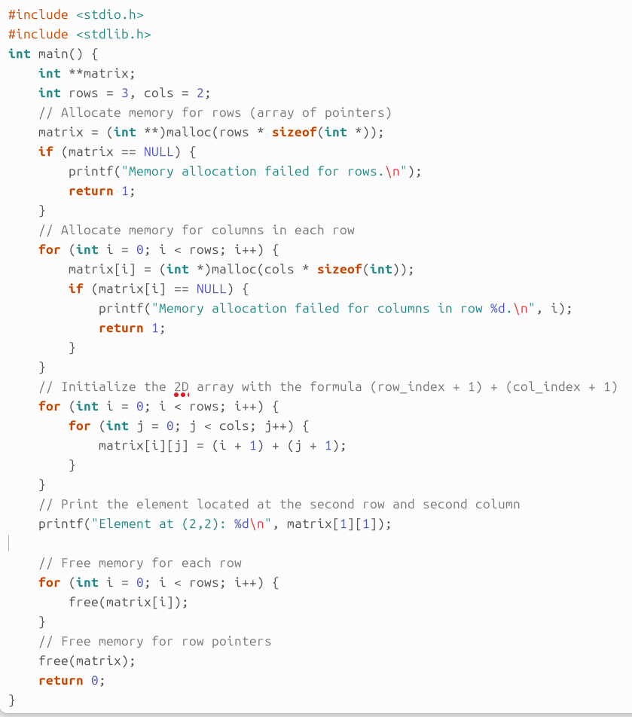
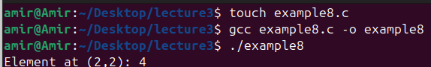
Example 8: Double Pointers
Write a C program that dynamically allocates a 2D array using double pointers.
Tasks:
Allocate memory for a 2D array with 3 rows and 2 columns.
Initialize the array such that each element is equal to its row index (starts at 1) plus its column index.
Print the element located at the second row and second column.
Free the memory allocated for the 2D array.

Slide 36
Example 8: Explanation
The use of ‘**’ in (int **matrix) is essential for handling a 2D array dynamically in C.
Memory Allocation:
The program first allocates memory for the array of pointers (rows) using malloc.
It then allocates memory for each row (columns) separately.
Initialization:
Each element in the 2D array is initialized using the formula (row_index + 1) + (col_index + 1) because indices in C start from 0, but the problem statement asks for indices starting from 1.
Access and Print:
The element at the second row and second column (which corresponds to matrix[1][1]) is accessed and printed.
Memory Deallocation:
The program deallocates the memory for each row, followed by the memory for the array of pointers.

Slide 37
Structures
A structure is a construct used to group a set of variables together under one name.
The first step in using a structure is to declare its organization.
For example:
struct person { /* "person" is name for structure type */
char first[32]; /* first field is array of char */
char last[32]; /* second field is array of char */
int year; /* third field is int */
double ppg; /* fourth field is double */
}; /* ending ; to end definition */
This code does not create a variable.
There are no bytes of storage named yet.
Instead, this code creates a template for a new variable type called struct person.
the struct person consists of two arrays of 32 char,
an int, and a double, for a total of 76 bytes.

Slide 38
Structures
We can use this definition of a struct person to declare a variable as follows:
struct person teacher;
We now have a variable named teacher that provides 76 bytes of storage.
Each part of the variable is called a field and is accessed using the period (.) symbol.
For example:
teacher.year=2006;
teacher.ppg=10.4;
strcpy(teacher.first,"Adam");
strcpy(teacher.last,"Hoover");

Slide 39
Structures
To copy one structure to another structure, one can use the following example code:
struct person mailman,teacher;
mailman=teacher; /* copy entire contents of struct */
Assigning a structure to another copies every byte.
Note: To copy structures, the structures must be of the same type.
To pass a structure as a parameter to a function, one can use the following example code:
When the function call to DisplayStats() is made, all 76 bytes in the variable teacher are copied to Input.
DisplayStats(struct person Input) { printf("%s, %s: %lf PPG in %d\n",Input.last,Input.first,Input.ppg,Input.year); } | main() { struct person teacher; DisplayStats(teacher); }

Slide 40
Example 9: Structures
Write a C program that defines a structure to store information about a student.
The structure should contain the following members:
name: a string (character array) to store the student's name.
rollNumber: an integer to store the student's roll number.
marks: a float to store the student's marks.
Write a function that takes this structure as input and prints the student's information. In the main function, create an instance of the structure, initialize it with some values, and then call the function to display the student's details.

Slide 41
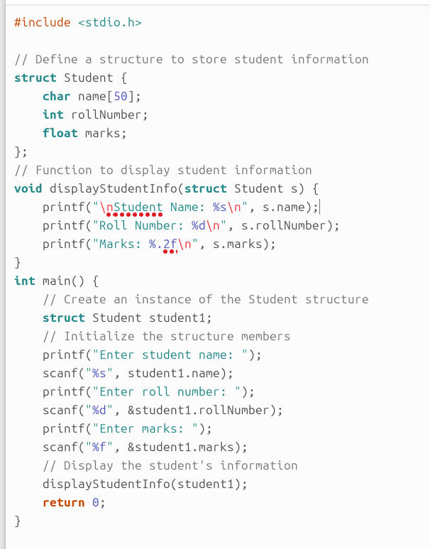
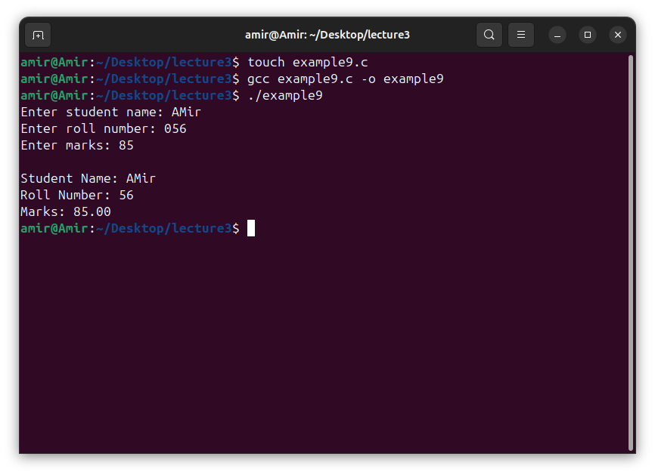
Example 9: Structures

Slide 42
Example 9: Explanation
Structure Definition:
The struct Student defines a template (blueprint) for the student data, with members for name, rollNumber, and marks.
Function to Display Student Info:
The displayStudentInfo() function takes a Student structure as an argument and prints its members.
Main Function:
In main(), an instance of Student called student1 is created.
The program prompts the user to enter the student's name, roll number, and marks.
The information entered by the user is then displayed using the displayStudentInfo() function.

Slide 43
Arrays and Structures
It is possible to create an array of structs, just like it is possible to have an array of any data type.
The template for the structure definition remains unchanged; it still must be declared first.
To use array with a structure, one can use the following example code:
strcpy is a function in the C standard library used to copy a string from one location (source) to another (destination).
The function is defined in the header file string.h
struct person class[54]; /* array of "struct person" */ class[0].year=2006; /* notice where array subscript goes */ class[0].ppg=5.2; strcpy(class[0].first,"Jane"); strcpy(class[0].last,"Doe"); | class[1].first[0]=’B’; /* array field in a struct array */ class[1].first[1]=’o’; class[1].first[2]=’b’; class[1].first[3]=0;

Slide 44
Example 10: Arrays and Structures
Write a C program that demonstrates the use of an array of structures.
The program should:
Define a global structure named fraction with two integer fields, x and y.
Inside the main() function, create an array of 3 fraction structures.
Initialize each element of the array with values for x and y.
Modify and print the values of the array elements using a separate function.

Slide 45
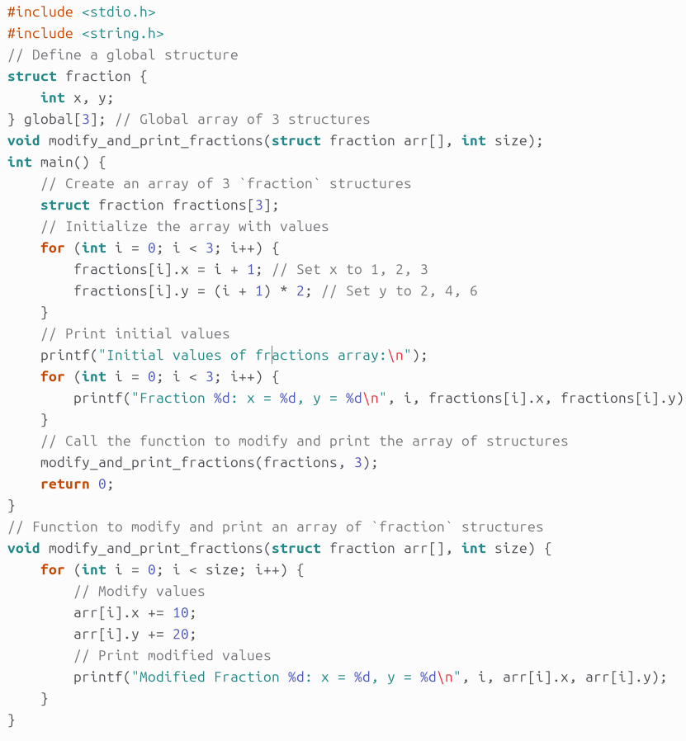
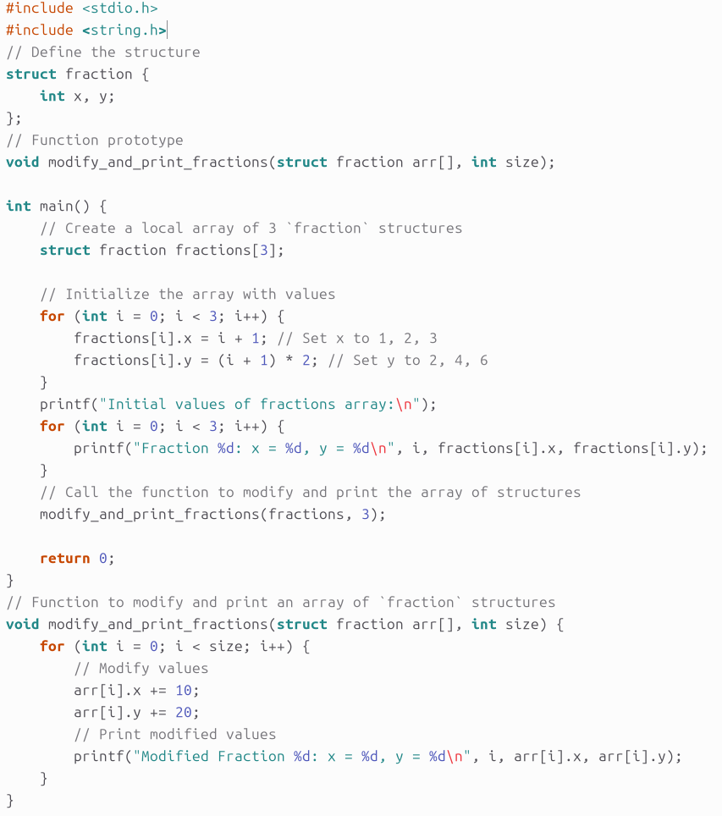
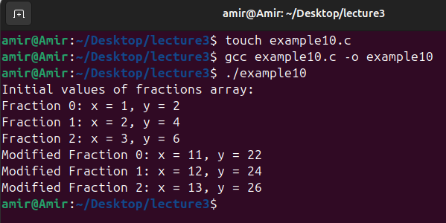
Example 10: Arrays and Structures
Global structure
Local structure

Slide 46
Example 10: Explanation
Global Structure Definition:
struct fraction is defined globally with two integer fields, x and y.
Global variables are declared outside of any function, usually at the top of the program, and can be accessed from any function within the same file.
The size of the global array is fixed at compile time and cannot be changed at runtime.
The memory for global is allocated statically. This means that memory is reserved for the array when the program starts and is deallocated when the program ends.
Array of Structures:
Inside the main() function, an array fractions of 3 fraction structures is created. Each element in this array is initialized with specific values for x and y.

Slide 47
Example 10: Explanation
Initialization:
The fractions array is initialized in a loop where x is set to i + 1 and y is set to (i + 1) * 2.
This initializes the array with values like:
Fraction 0: x = 1, y = 2
Fraction 1: x = 2, y = 4
Fraction 2: x = 3, y = 6
Function modify_and_print_fractions():
This function takes an array of fraction structures and its size as parameters.
It modifies each element in the array by adding 10 to x and 20 to y.
The modified values are then printed.

Slide 48
Nested Structures
Structures can be nested, so that a field within a structure is itself another structure.
The label boss is a name for a struct person (72 bytes), while the label boss title is a name for a struct name (64 bytes).
struct name { char first[32]; char last[32]; }; | struct person { int age; float ppg; struct name title; /* nested structure */ }; /* "name" must be defined above */
struct person boss; boss.age=80; boss.ppg=0.1; strcpy(boss.title.first,"Dean"); strcpy(boss.title.last,"Smith");

Slide 49
Pointers and Structures
The address of a structure variable can be stored in a pointer variable, just like the address of any other type of variable.
g=&(f[0]): This line sets the pointer g to point to the first element of the array f. The address of f[0] (the first struct fraction in the array) is assigned to g.
(*g).x=5: This line uses the dereferencing operator * to access the structure that g points to. (*g).x refers to the x field of the structure. This sets x of f[0] to 5.
g->y=11: This is a shorthand notation for accessing a member of a structure through a pointer. g->y is equivalent to (*g).y. This sets y of f[0] to 11.
The -> syntax (hyphen followed by greater-than symbol) means in the field at the given address.
struct fraction { int x; int y; } | struct fraction f[3],*g; g=&(f[0]); (*g).x = 5; g->y = 11;

Slide 50
Example 11: Pointers and Structures
Write a C program that demonstrates how to use pointers to structures and pointer arithmetic.
The program should:
Define a structure named fraction with two integer members x and y.
Create an array of three fraction structures.
Use a pointer to traverse and modify the elements of this array.
Print out the values of the array elements at each step using both direct structure access and pointer dereferencing.
Tasks:
Initialize the first element of the array with x = 3 and y = 7.
Print the values of the first element using the pointer.
Move the pointer to the second element and set x = 13 and y = 17, then print the values.
Move the pointer to the third element, modify its values to x = 23 and y = 27, and then print the values.

Slide 51
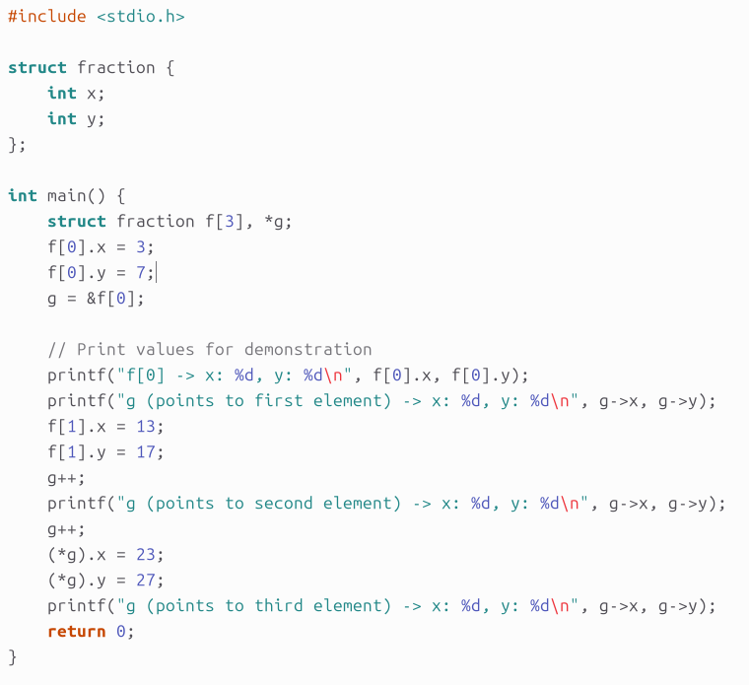
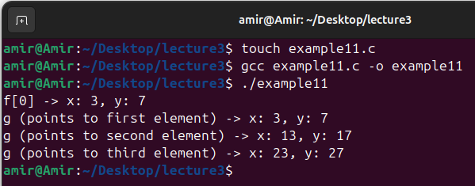
Example 11: Pointers and Structures

Slide 52
Example 11: Explanation
Structure Definition:
The program defines a struct fraction with two integer fields, x and y, representing a fraction.
Array of Structures:
An array f of three fraction structures is created, allowing the storage of three different x, y pairs.
Pointer to Structure:
A pointer g of type struct fraction* is used to traverse the array. Initially, it is set to point to the first element of the array, f[0].

Slide 53
Example 11: Explanation
Pointer Arithmetic:
The pointer g is incremented (g++) to move to the next element in the array. Each increment moves the pointer to the next struct fraction in memory.
Accessing Structure Members:
g->x and g->y are used to access the x and y members of the structure that g currently points to.
(*g).x and (*g).y are alternative ways to access the same members, where (*g) dereferences the pointer to access the structure itself.
Output:
The program prints the values of the x and y members for each element of the array after each modification.

Slide 54
Example 12: Structures
Write a C program to model a rectangle in a 2D plane using structures. The rectangle's sides are parallel to the x and y axes, and its corners are defined by their compass directions (northeast, southeast, southwest, and northwest).
Implement two functions:
RectArea(): This function calculates the area of the rectangle.
RotateRect(): This function rotates the rectangle 90 degrees clockwise. The function should have one parameter that passes the rectangle in and out. The function should have no return value.
Your program should:
Define the rectangle with initial coordinates {{6, 5}, {6, 2}, {2, 2}, {2, 5}}.
Calculate and print the area of the rectangle.
Rotate the rectangle 90 degrees clockwise and then print the new coordinates of the rectangle's corners.

Slide 55
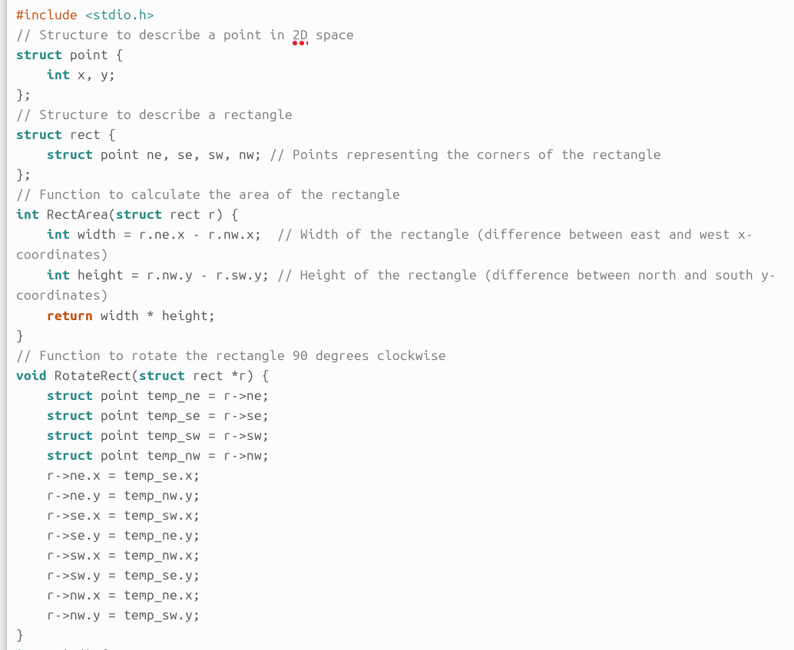
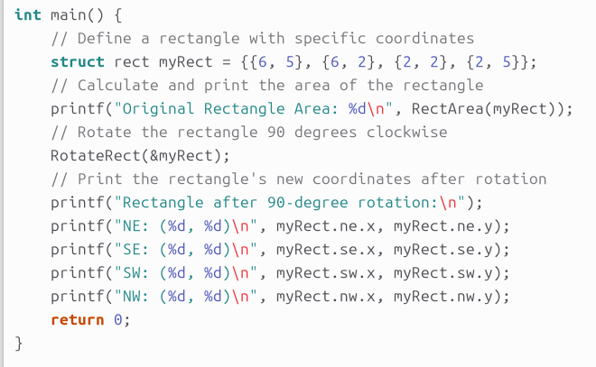
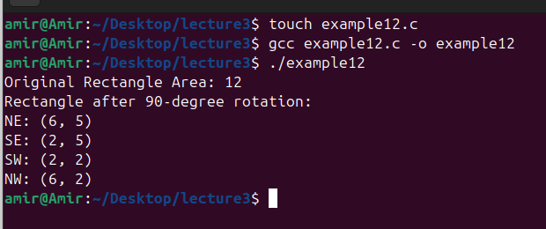
Example 12: Structures

Slide 56
Example 12: Explanation
Structures:
struct point: Represents a point in 2D space using x and y coordinates.
struct rect: Represents a rectangle defined by four points (ne, se, sw, nw), which correspond to the rectangle's corners.
RectArea() Function:
Computes the area of the rectangle by calculating the width and height.
Width is computed as the difference between the x coordinates of the northeast (ne) and northwest (nw) points.
Height is computed as the difference between the y coordinates of the northwest (nw) and southwest (sw) points.
The area is the product of the width and height.

Slide 57
Example 12: Explanation
RotateRect() Function:
Rotates the rectangle 90 degrees clockwise by updating the coordinates of each corner.
It uses temporary variables to hold the original coordinates while updating the rectangle's corners based on the clockwise rotation.
main() Function:
Initializes a rectangle myRect with specific corner coordinates.
Prints the area of the rectangle using RectArea().
Rotates the rectangle 90 degrees clockwise using RotateRect().
Prints the updated corner coordinates after the rotation.

Slide 58
Thank you for listening

